Slide 1
Famous Canadians
Toshiya T. Matsushita

Slide 2
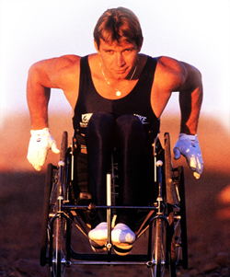
Rick Hansen
I was born on August 26th 1957 in Port Alberni, British Columbia.
As a child, I enjoyed lots of sports including basketball and volleyball.
At the age of 15, I was in a car crash and received a spinal cord injury and was confined to a wheelchair. I then played wheelchair sports.
I won 6 paralympic games medals and became famous for my “Man in Motion” world tour, raising money for spinal cord injury research.
Who am I?

Slide 3
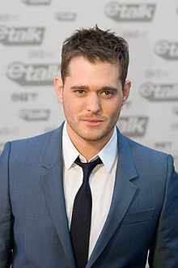
Michael Bublé
I was born on September 9th 1975 in Burnaby, British Columbia.
I am a successful singer and songwriter. I have won 3 Grammy awards and 11Juno awards.
I was first discovered by former prime minister Brian Mulroney in 2000 and was invited to sing at his daughter’s wedding.
My first album was released on February 11th, 2003. This self titled album made it to the top 10 in Canada.
My more famous songs include “Fever”, “Moondance” and “Come Fly With Me.”
Who am I?

Slide 4
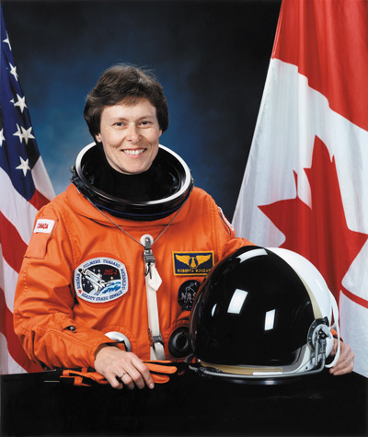
Roberta Bondar
I was born on December 4th 1945 in Sault Ste. Marie, Ontario.
I received a bachelor of Science Degree in Zoology and Agriculture, a doctorate in Neurology, a Doctor of medicine degree, and a Master of Science degree in experimental pathology all in 6 years.
I went into space in 1992 to research the complex effects of weightlessness in living organisms.
I was the first neurologist and first Canadian woman in space.
Who am I?

Slide 5
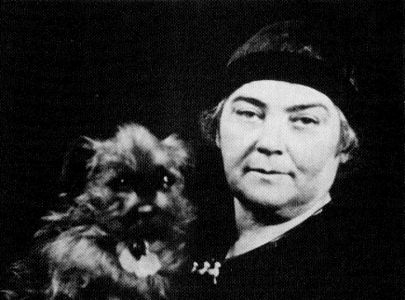
Emily Carr
I was born on December 13th, 1871 in Victoria British Columbia and I died on March 2nd 1945 at the age of 73.
I left Canada to study art in San Francisco, France and London and returned home in 1905 to briefly pursue a career in teaching art to women only, losing the job due to incessant smoking and swearing at art students.
I was lucky enough to become associated with the famous “Group of Seven,” though not formally a member.
My house is now is now declared a historic site and many schools have been built in my honor.
My works are inspired by indigenous work and I mostly paint nature scenes and totem poles, which is now thought to be cultural appropriation.
Who am I?

Slide 6
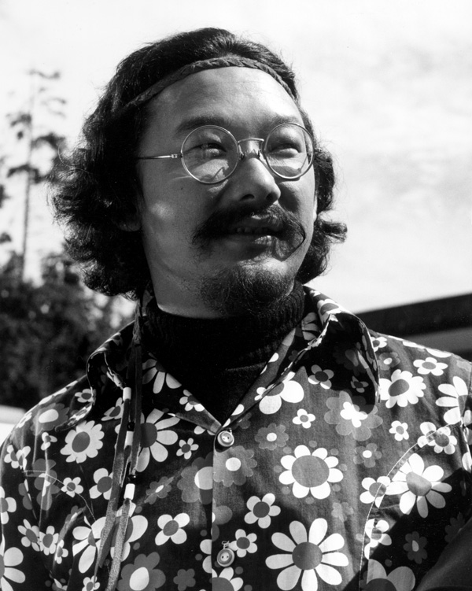
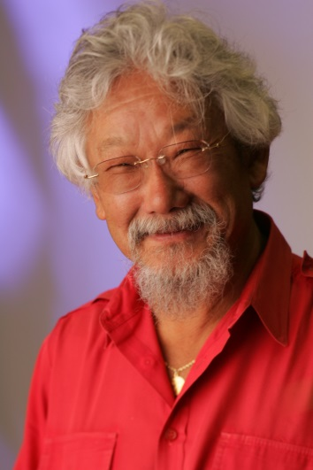
David Suzuki
I was born on March 24th 1936 in Vancouver, British Columbia.
As a child, I had to live in an interment camp in British Columbia during the Second World War because of my race.
I received my Bachelor of Arts in Biology in 1958 from Amherst College in Massachusetts and my Ph.D. in Zoology from the University of Chicago in 1961.
When giving speeches, I prefer to do so by video conference so as to not increase my carbon footprint.
I host the CBC television series The Nature of Things where I discuss the nature and well-being of the planet.
Who am I?

Slide 7
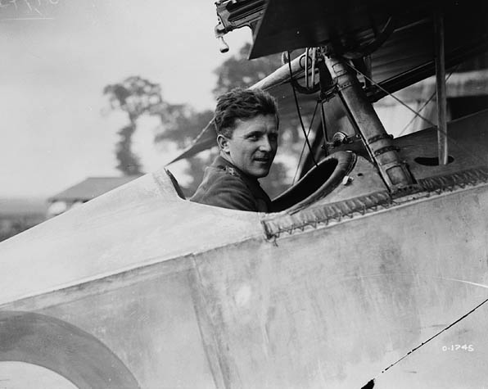
William “Billy” Avery Bishop
I was born on February 8th 1894 in Owen Sound, Ontario and I died on September 11th 1956.
A lazy student, I was about to be kicked of out RMC in Kingston when the First World War broke out.
I was a fighter pilot throughout WWI and also helped recruit and train fighters in WWII, defying the average life expectancy of a WWI pilot (11 days)
During WWI, I was 3rd top “Ace” reporting 72 planes shot down, following the kills attributed to René Fonck and the Red Baron.
Who am I?

Slide 8
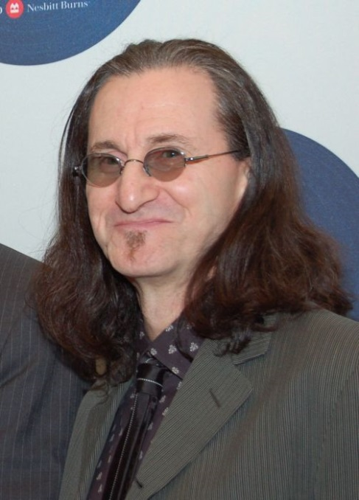
Geddy Lee
I was born on July 29th, 1953 in Willowdale, Ontario.
I am married to Nancy Young and we have 2 children, named Kyla and Julian.
I am a singer and songwriter. I play a few instruments, particularly bass guitar and keyboard.
My birth name is “Gary Lee Weinrib.”
Some of my more famous songs include “Tom Sawyer” and “Closer to the Heart”
Who am I?

Slide 9
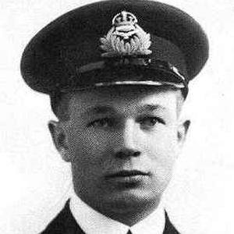
Roy Brown
I was born on December 23, 1893 in Carleton Place, Ontario and I died on March 9, 1944.
I was a fighter pilot during the First World War.
I trained my new pilots very carefully and was protective of them; so much so that I lost not a single pilot under my supervision while in combat.
I was, in fact, pursuing and shooting at deadly German fighter ace the Red Baron to keep him from downing one of my pilots, when the German was shot down. I was credited with shooting him down, but this is fairly unlikely.
Who am I?

Slide 10
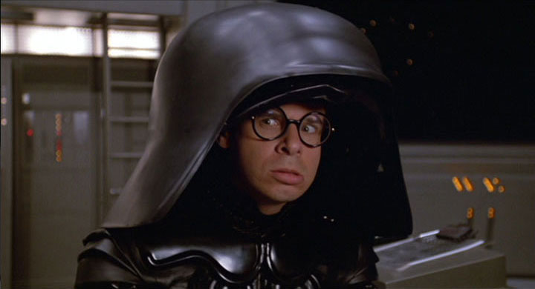
Frederick Allan “Rick” Moranis
I was born on April 18th, 1953 in Toronto, Ontario.
I began my entertainment career as a radio disk jockey in the mid-1970’s, moving into Canadian comedy television.
I have starred in movies such as Honey, I Shrunk the Kids, Spaceballs, and Ghostbusters.
I stopped making movies 6 years after the loss of my wife to breast cancer in order to raise my children as a single dad, but I have still done a few voice acting jobs.
I attended elementary school with Geddy Lee and in 1982, he helped me and my friend “Doug Mackenzie” write our hit song “Take Off.”

Slide 11
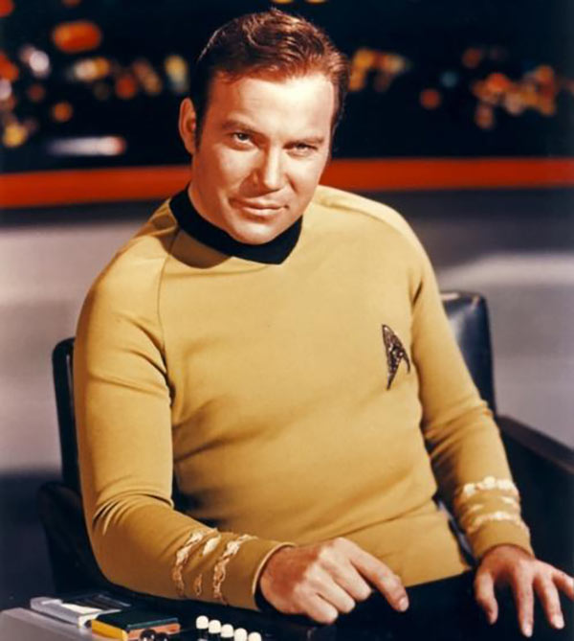
William Shatner
I was born March 22, 1931 in Montreal, Quebec.
I was a great “draw” as a Shakespearean actor in Canada before starting work in American television in the 1960s, at which time I displayed my overly dramatic “stage” style of delivering lines.
I was the first actor to play Captain James T. Kirk on the science fiction show Star Trek.

Slide 12
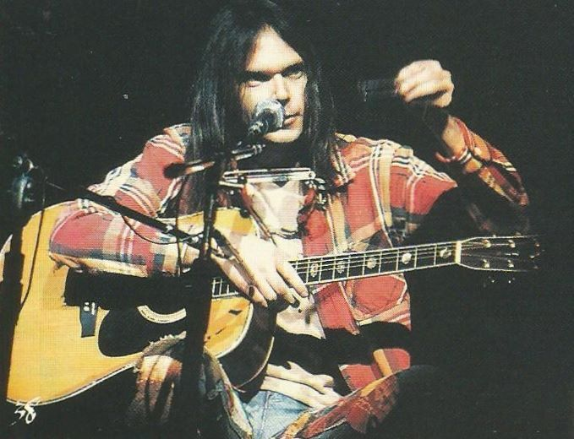
Neil Young
I was born on November 12th, 1945 in Toronto, Ontario.
I began my American music career in the band Buffalo Springfield, whose hit song “For What It’s Worth” says “Stop children, what’s that sound?”
I was at Woodstock, but did not perform.
I play piano, harmonica and guitar, and sing in a high, wobbly voice.
My hits include “Heart of Gold,” “After the Gold Rush,” and “Keep On Rockin’ in the Free World.”

Slide 13
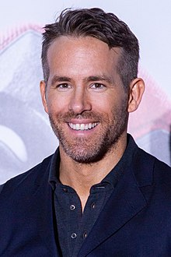
Ryan Reynolds
I was born on October 23, 1976 in Vancouver, British Columbia.
I began my entertainment career working on Canadian TV in the 90s, moving into American TV, and from there into motion pictures.
I played two different superheroes, one owned by Marvel and one by D.C., in two extremely unsuccessful and unpopular big budget movies, and then was hired to play the first of those two characters again in a new movie franchise featuring him.
At age 40, I really hit it big in Hollywood with this superhero franchise.
I am married to actress Blake Lively.

